Slide 1
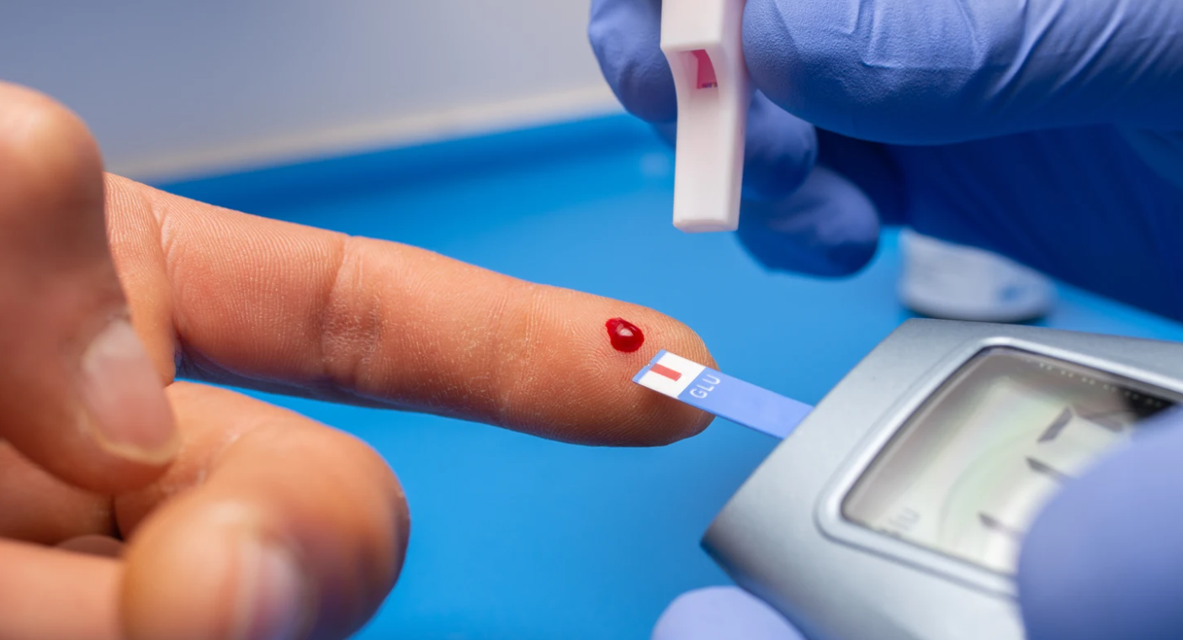
Diabetes Classification with Machine Learning Techniques
Francisco Chavez

Slide 2


Slide 3
Defining Diabetes
According to the Centers for Disease Control and Prevention (CDC), Diabetes is a chronic (long-lasting) health condition that affects how your body turns food into energy.
The body doesn’t make enough insulin or can’t use it as well as it should. When there isn’t enough insulin or cells stop responding to insulin, too much blood sugar stays in your bloodstream. Over time, that can cause serious health problems, such as heart disease, vision loss, and kidney disease.

Slide 4
Types of diabetes
Type 1
Caused by an autoimmune reaction (the body attacks itself by mistake). This reaction stops your body from making insulin.
Type 2
Your body doesn’t use insulin well and can’t keep blood sugar at normal levels. About 90-95% of people with diabetes have type 2
Gestational Diabetes
Develops in pregnant women who have never had diabetes. If you have gestational diabetes, your baby could be at higher risk for health problems
Prediabetes
Blood sugar levels are higher than normal, but not high enough for a type 2 diabetes diagnosis.

Slide 5

Dataset Selection
The Diabetes Health Indicators Dataset, according to the UC Irvine Machine Learning Repository, comprises a collection of healthcare statistics and lifestyle survey responses from individuals, encompassing their diabetes diagnosis. It includes 35 features covering demographic data, laboratory test outcomes, and survey responses for each participant. The primary focus of classification is determining the health status of patients, classifying them as having diabetes, being pre-diabetic, or maintaining a healthy condition.

Slide 6
Data info
0 null values
254680 entries
22 columns
24206 duplicate values

Slide 7
Features
Diabetes: Binary 0=No 1=Yes
High Blood Pressure : Binary 0=No 1=Yes
High Cholesterol: Binary 0=No 1=Yes
Cholesterol Check in 5 years: Binary 0=No 1=Yes
Body Mass Index: Float
Smoker: Binary 0=No 1=Yes
Stroke: Binary 0=No 1=Yes
Heart Diseaseor Attack: Binary 0=No 1=Yes
Physical Activity: Binary 0=No 1=Yes
Fruits: Binary 0=No 1=Yes
Veggies: Binary 0=No 1=Yes
Heavy Drinkers: Binary 0=No 1=Yes
Health Care: Binary 0=No 1=Yes
Visit Doctor: Binary 0=No 1=Yes
General Health: Range in categories
Mental Health: Range in days
Physical Health: Range in days
Difficulty Walking: Binary 0=No 1=Yes
Sex: : Binary 0=Female 1=Male
Age: Range
Education: Range in categories
Income: Range in categories

Slide 8
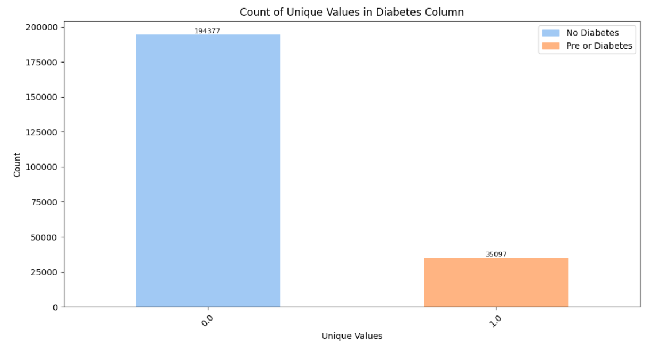
Diabetes Column

Slide 9
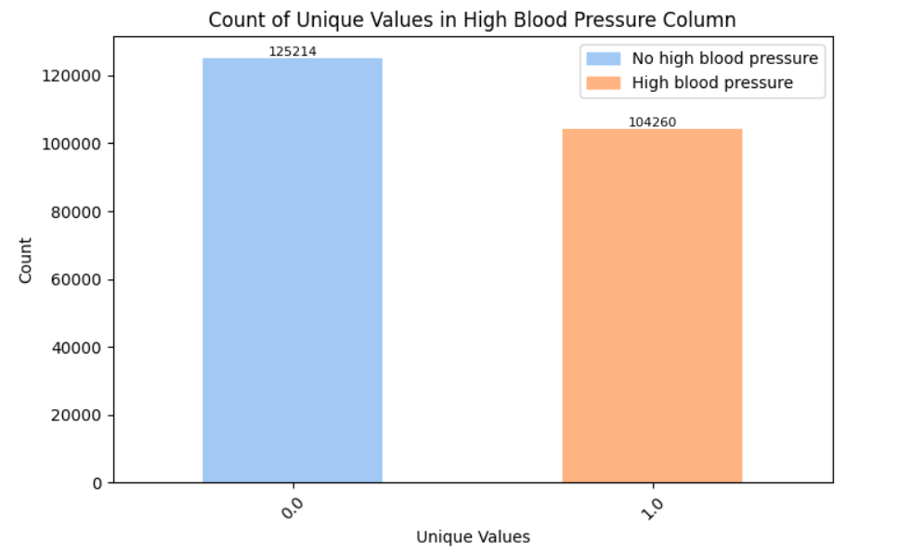
High Blood Pressure Column
According to the American Heart Association (AHA) guidelines high blood pressure is categorized as follows
Normal: Systolic <120 mmHg and Diastolic <80 mmHg
Elevated: Systolic 120-129 mmHg and Diastolic <80 mmHg
Hypertension Stage 1: Systolic 130-139 mmHg or Diastolic 80-89 mmHg
Hypertension Stage 2: Systolic ≥140 mmHg or Diastolic ≥90 mmHg
High Blood Pressure indicates that the individual's blood pressure falls into either the Hypertension Stage 1 or Hypertension Stage 2 category.

Slide 10
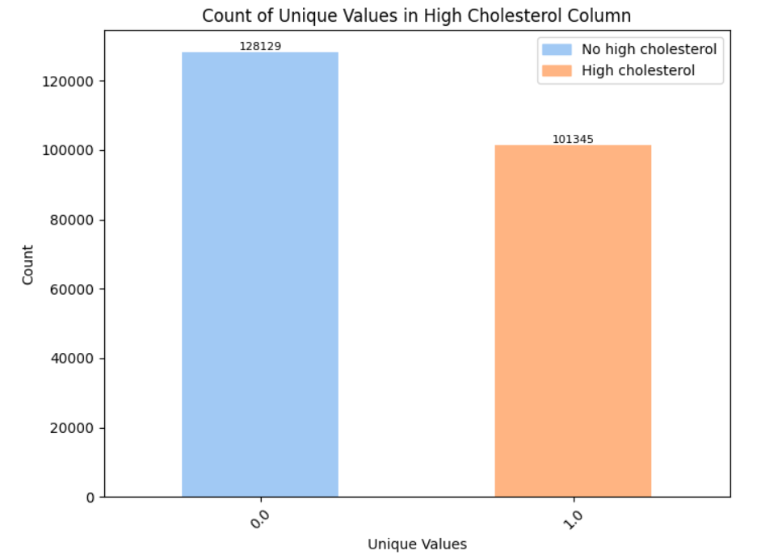
High cholesterol
Refers to elevated levels of cholesterol in the blood, specifically low-density lipoprotein (LDL) cholesterol, often referred to as "bad" cholesterol. Cholesterol is a waxy, fat-like substance found in the cells of the body and certain foods. While cholesterol is essential for the body to function properly, having too much LDL cholesterol can increase the risk of heart disease and other cardiovascular problems.

Slide 11
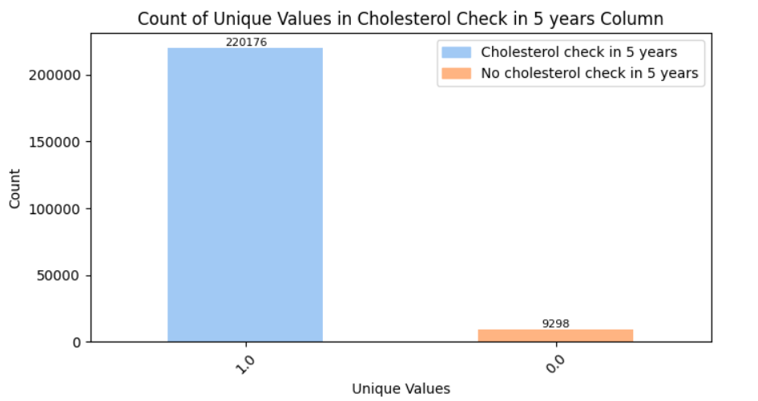
Cholesterol check in 5 years

Slide 12
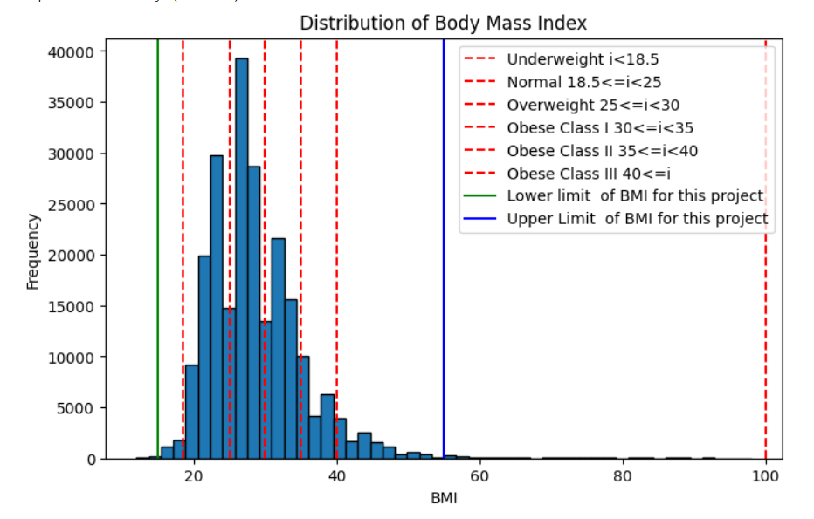
Body Mass Index (BMI)
Measure of body fat based on height and weight that applies to adult men and women. BMI is calculated by dividing a person's weight in kilograms by the square of their height in meters. The result is typically categorized into the following BMI ranges, according to the World Health Organization (WHO):
Underweight: BMI less than 18.5
Normal weight: BMI 18.5 to 24.9
Overweight: BMI 25 to 29.9
Obesity (Class 1): BMI 30 to 34.9
Obesity (Class 2): BMI 35 to 39.9
Obesity (Class 3): BMI 40 or higher

Slide 13
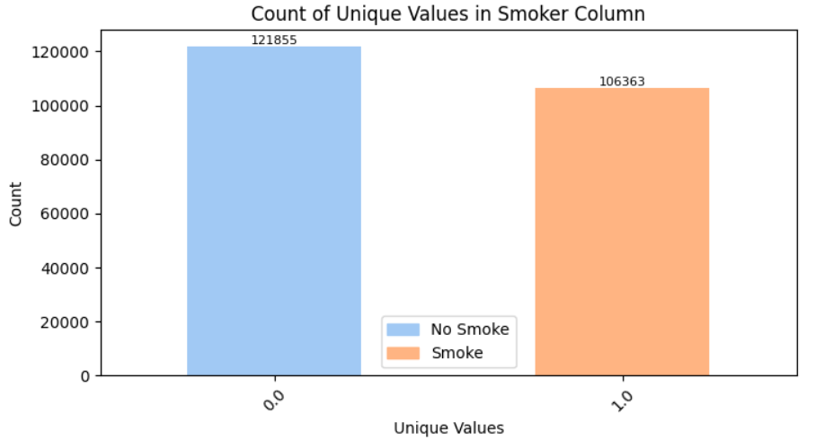
Smoker
According to the Office on Smoking and Health, the National Center for Chronic Disease Prevention and Health Promotion, and the Centers for Disease Control and Prevention, smoking is one cause of type 2 diabetes. In fact, people who smoke cigarettes are 30%–40% more likely to develop type 2 diabetes than people who don’t smoke

Slide 14
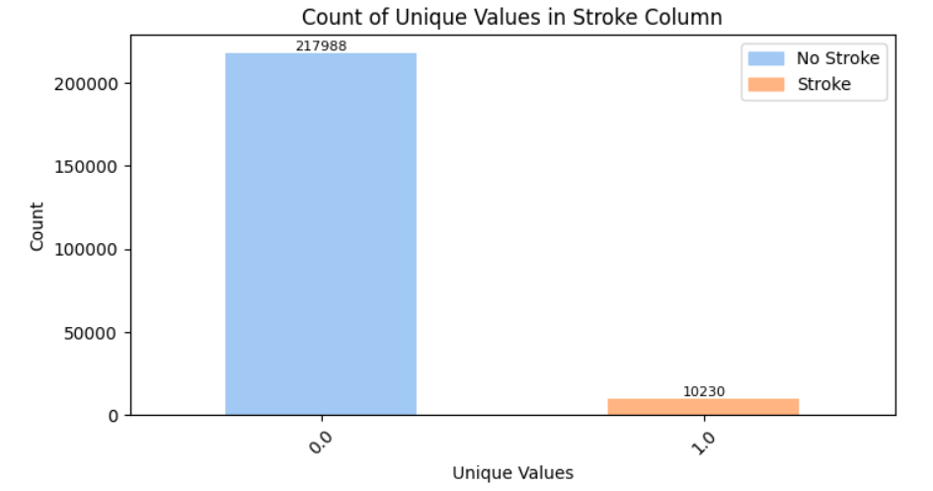
Strokes
According to the 'Diabetes and Stroke: Epidemiology, Pathophysiology, Pharmaceuticals, and Outcomes' publication retrieved from the National Library of Medicine, uncontrolled diabetes puts individuals at risk for both ischemic and hemorrhagic strokes. There are specific clinical patterns of ischemic stroke observed in individuals with diabetes.

Slide 15
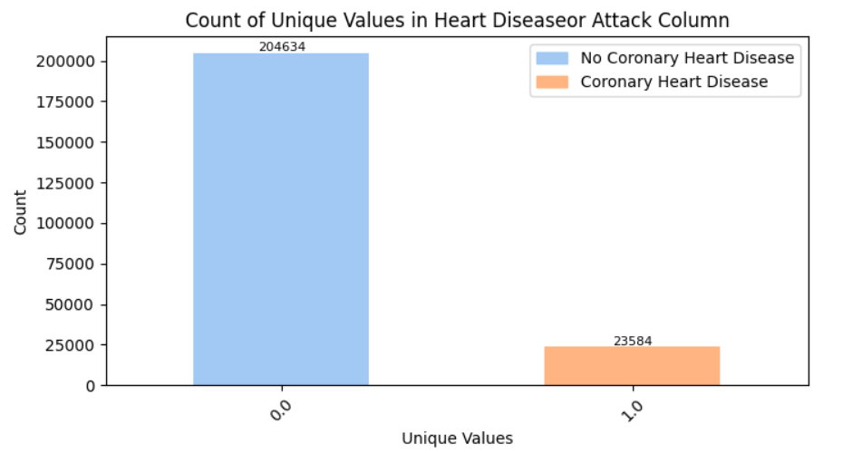
Heart Diseaseor Attack
According to the Centers for Disease Control and Prevention (CDC), individuals with diabetes are twice as likely to experience heart disease or a stroke compared to those without diabetes—and often at a younger age. Moreover, the longer one has diabetes, the higher the likelihood of developing heart disease.

Slide 16
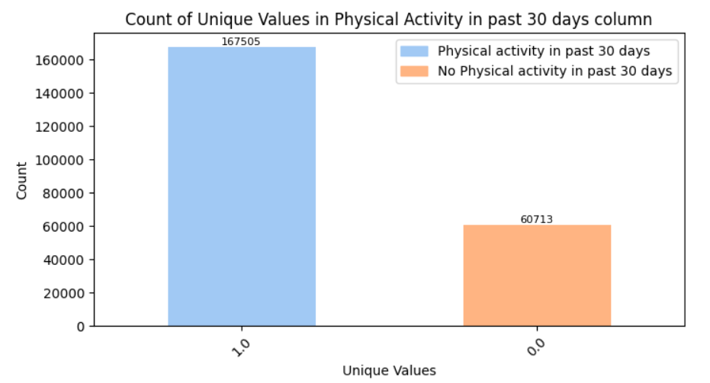
Physical Activity
According to the Centers for Disease Control and Prevention (CDC), Physical activity also helps control blood sugar levels and lowers your risk of heart disease and nerve damage.

Slide 17
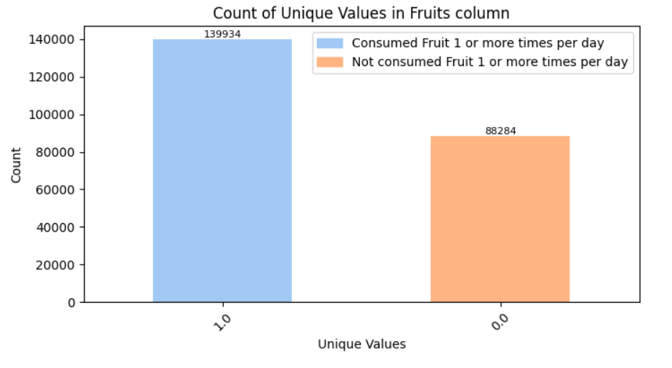
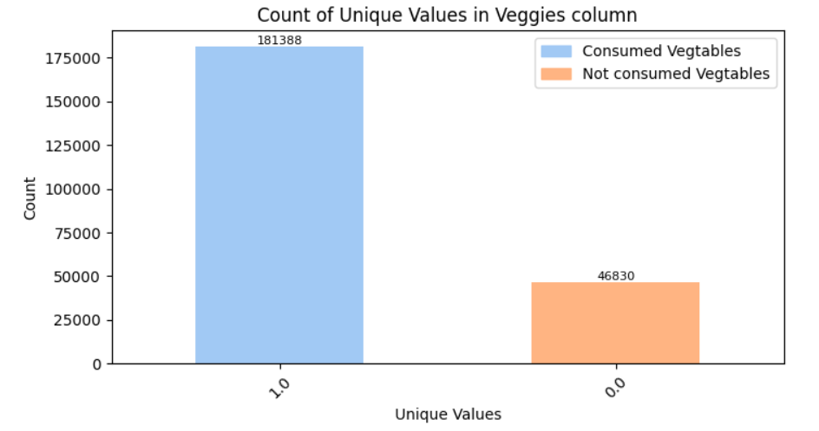
Fruits and Veggies

Slide 18
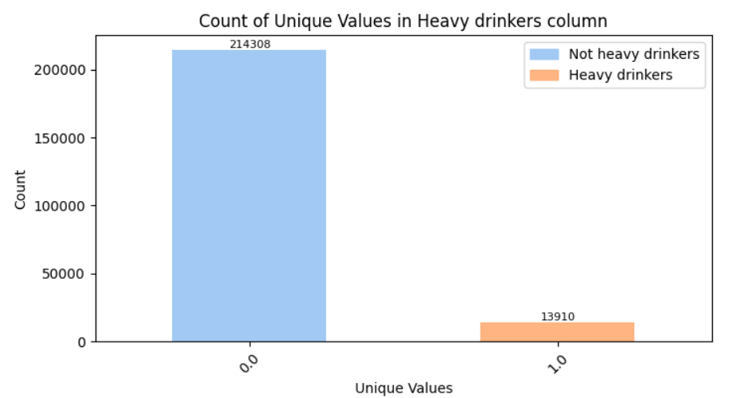
Heavy drinkers
According to the 'Consequences of Alcohol Use in Diabetics' publication retrieved from the National Library of Medicine, Heavy drinking, particularly in diabetics, also can cause the accumulation of certain acids in the blood that may result in severe health consequences.

Slide 19
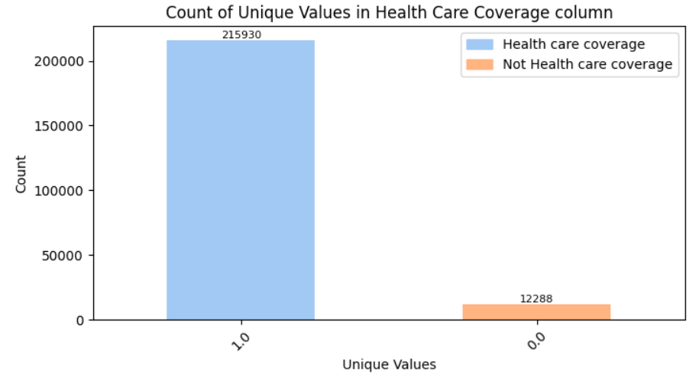
Health Care Coverage

Slide 20
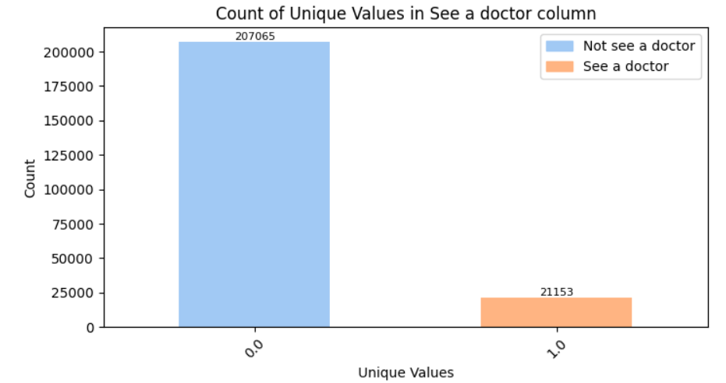
See a doctor

Slide 21
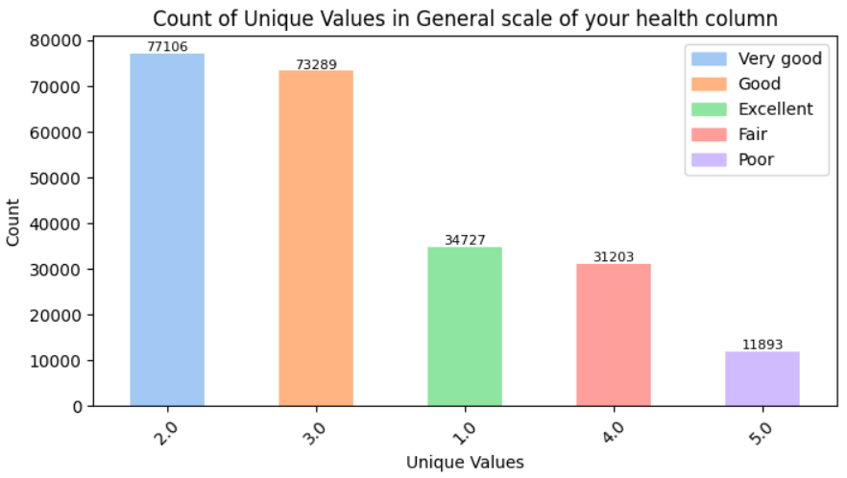
General scale of your health

Slide 22
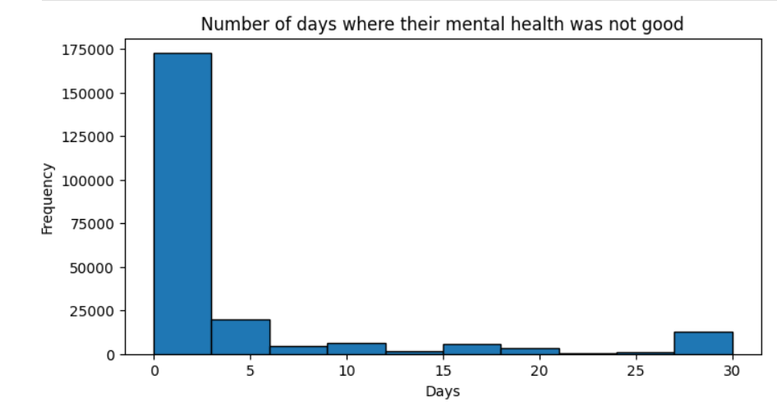
Mental Health

Slide 23
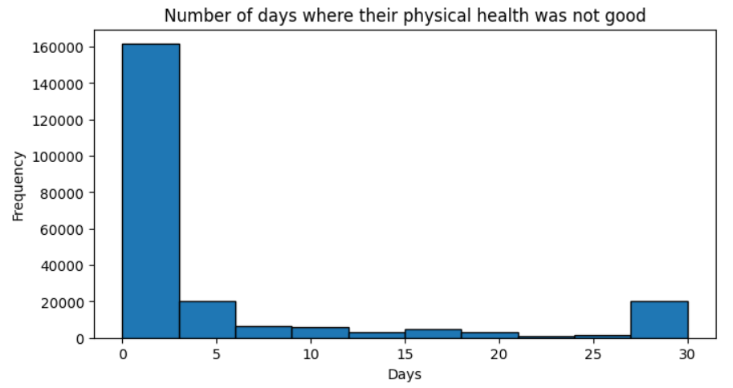
Physical Health

Slide 24
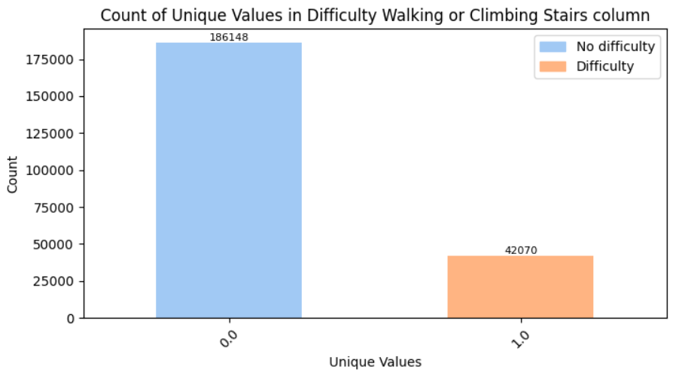
Difficulty Walking or Climbing Stairs

Slide 25
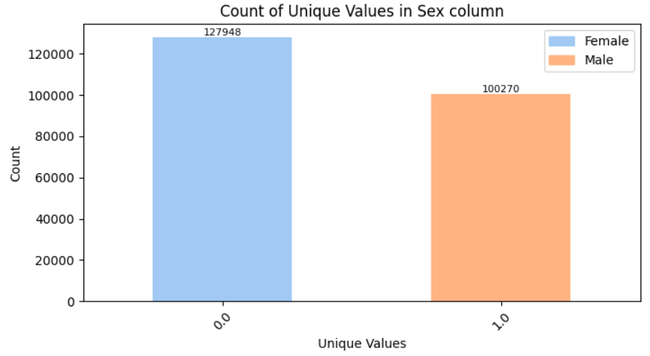
Gender
The probability of having diabetes can vary depending on gender due to differences in biological factors, lifestyle behaviors, and other risk factors.
Type 1 Diabetes: Type 1 diabetes occurs equally in both genders
Type 2 Diabetes: Historically, men have had a slightly higher prevalence of type 2 diabetes compared to women Some studies suggest that women may have a higher risk of developing type 2 diabetes at a lower body mass index (BMI) compared to men, indicating that women may be more susceptible to the metabolic effects of obesity.
Gestational Diabetes: Gestational diabetes occurs only in pregnant women and typically resolves after childbirth and can also affect the fetus.

Slide 26
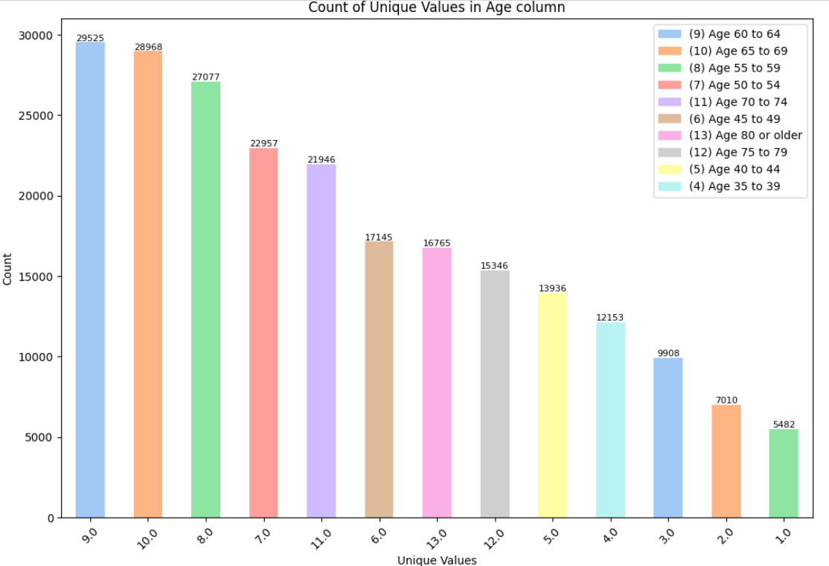
Age
Age is a significant factor in the development and management of diabetes
Type 1 Diabetes: Type 1 diabetes often manifests in childhood or adolescence, although it can occur at any age. It is less common in older adults but can still occur.
Type 2 Diabetes: The risk of developing type 2 diabetes increases with age. It is most commonly diagnosed in adults, particularly those over the age of 45. However, there is a growing trend of type 2 diabetes being diagnosed at younger ages, including in children, adolescents, and young adults.
Gestational Diabetes: Gestational diabetes occurs during pregnancy and typically resolves after childbirth. Advanced maternal age (over 35 years old) is a risk factor for gestational diabetes.

Slide 27
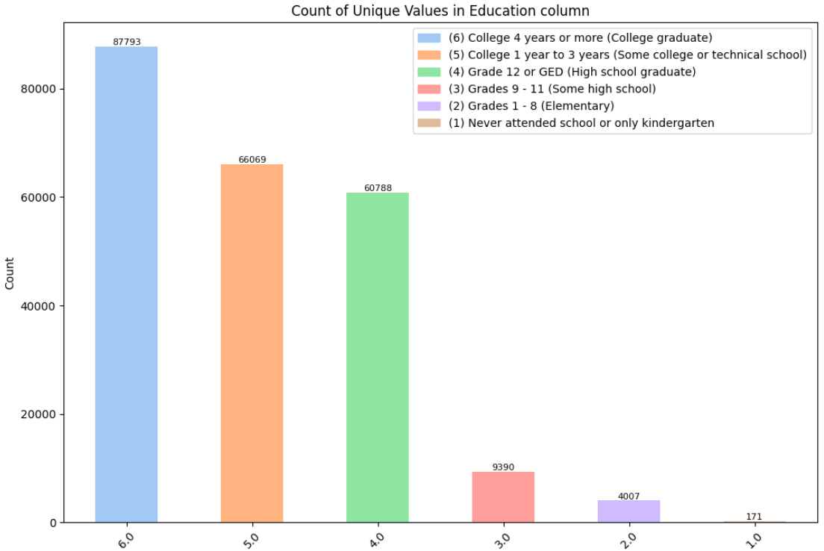
Education
According to the Centers for Disease Control and Prevention, individuals who have not completed high school have the highest prevalence of diabetes, whereas those with more than a high school education have the lowest prevalence.

Slide 28
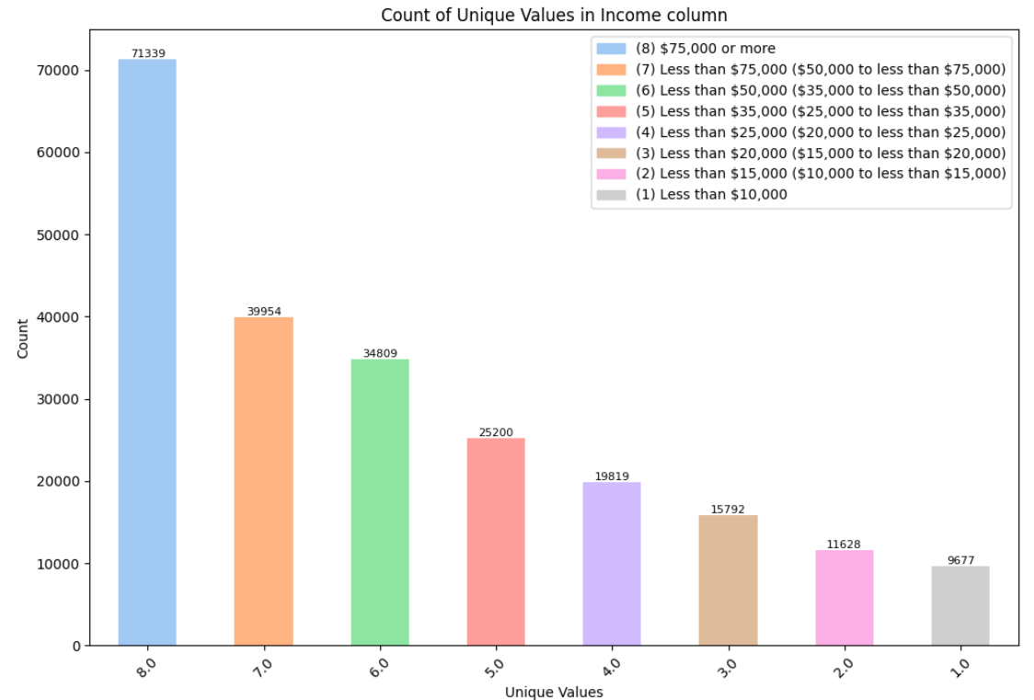
Income
According to the Centers for Disease Control and Prevention, Adults with a family income below the federal poverty level (FPL) have the highest prevalence of diabetes.

Slide 29
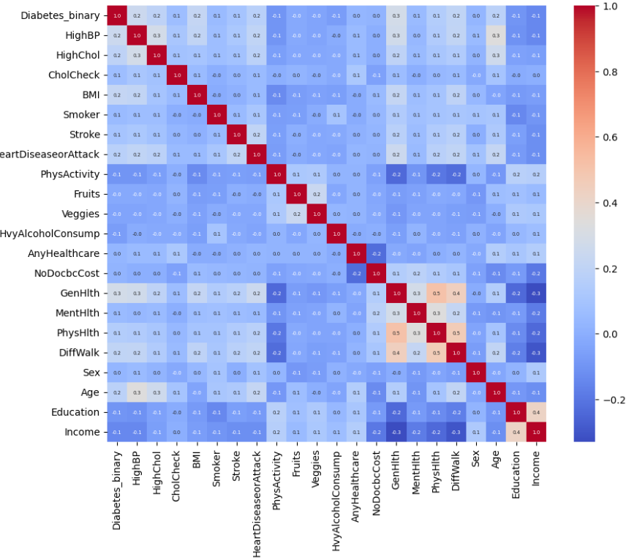
Correlation Matrix

Slide 30
Feature Selection
Recursive Feature Elimination (RFE)
Tree-Based Models
Lasso
Chi Squared
Forward Selection
Backward Selection

Slide 31
Final predictors
GenHlth
HighBP
BMI
HighChol
Age

Slide 32
Machine Learning Models
Logistic Regression
Decision Trees
Random Forest
Boosting
Neural Networks

Slide 33
Logistic Regression
Initial Recall: 84.8107%
Gridsearch
Penalty term
C
Solver
Max_Iterations
Final Recall: 84.8108%
Time: 643s

Slide 34
Decision Trees
Initial Recall: 84.58%
Gridsearch:
Max_depth
Min_samples_split
Min_samples_leaf
Criterion
Final Recall: 84.6442%
Time: 42s

Slide 35
Random Forest
Initial Recall: 84.58%
Gridsearch:
Max_depth
Min_samples_split
Min_samples_leaf
N_estimators
Final Recall: 84.9860%
Time: 485s

Slide 36
Boosting
Initial Recall: 84.96%
Gridsearch:
Max_depth
Min_samples_split
Min_samples_leaf
Learning rate
Final Recall: 85.0911%
Time: 208s

Slide 37
Neural Networks
Initial Recall: 85.00%
Gridsearch:
Activation Function
Optimizer
Neurons
Epoch
Final Recall: 85.0451%
Time: 607

Slide 38
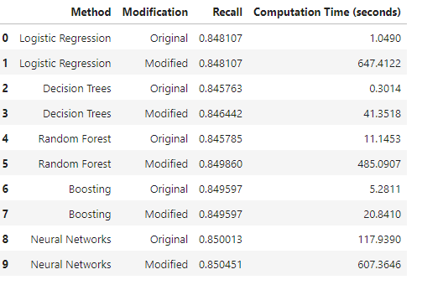
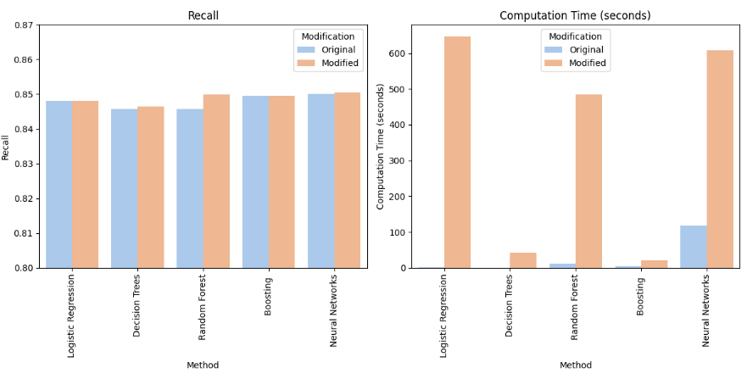
Summary

Slide 39
Recommendations
Based on the results obtained and to further enhance model performance, several strategies can be considered. First, feature selection techniques can be employed to identify and incorporate more relevant features from the dataset, which may provide additional insights and improve model accuracy.
In addition to the models already explored, introducing Support Vector Machine (SVM) could offer an alternative approach to diabetes classification. SVM is known for its effectiveness in handling complex datasets and is particularly well-suited for binary classification tasks like diabetes prediction.
Furthermore, while optimizing hyperparameters is essential for maximizing model performance, it's crucial to strike a balance between improved accuracy and computational resources. Careful consideration should be given to the computational cost associated with selecting additional hyperparameters, as this could lead to increased computational usage and potentially higher expenses.

Slide 40
References
https://archive.ics.uci.edu/dataset/891/cdc+diabetes+health+indicators
https://www.kaggle.com/datasets/alexteboul/diabetes-health-indicators-dataset/data
https://www.cdc.gov/diabetes/library/features/diabetes-and-women.html
https://www.cdc.gov/
https://www.ncbi.nlm.nih.gov/pmc/articles/PMC9408508/
https://www.niddk.nih.gov/health-information/diabetes/overview/healthy-living-with-diabetes?dkrd=/health-information/diabetes/overview/diet-eating-physical-activity#:~:text=Try%20to%20limit%20carbohydrates%20with,low%2Dfat%20or%20nonfat%20milk.
https://www.cdc.gov/diabetes/health-equity/diabetes-by-the-numbers.html
https://www.cdc.gov/diabetes/library/socialmedia/infographics.html
https://pubmed.ncbi.nlm.nih.gov/36897358/#:~:text=Worldwide%2C%20an%20estimated%2017.7%20million,in%20diabetes%20risk%20in%20women

Slide 41

Thanks
https://github.com/franciscochavezing/DIABETES-CLASSIFICATION

